Slide 1
I’ll take care of me…
That’s my priority!

Slide 2
Part I:
Our needs lead to choices
(good or bad)

Slide 3
On your reflection sheet…
What does each term mean?
Freedom
Belonging
Fun
Power
Notes:
Each student gets a half-sheet of paper on which they define what each of the following terms means: freedom, power, belonging, fun. Students turn and talk to share their definitions and see what is similar/different. Share out a few examples as a whole class.
What are some examples at home?
What are some examples at school?
As a class, brainstorm school examples of each term. Chart them on the board. Share with the class that these are the 4 basic human needs to live a happy, healthy and emotionally stable life (beyond the basic needs of clothing, food and shelter, of course).

Slide 4
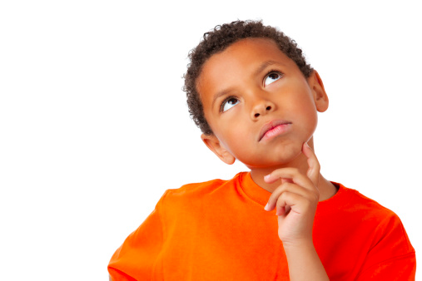
What are your thoughts?
How would having these four basic needs met at school help you enjoy school more?
Notes:
Ask: How would having these four basic needs met at school help you enjoy school more?

Slide 5
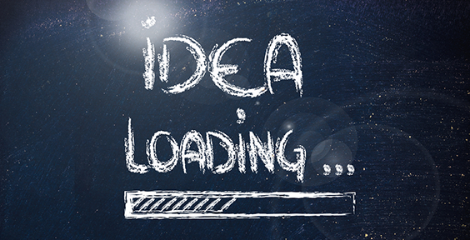
It could be true that…
Getting the MOST freedom, power, belonging and fun as possible while at school means that we need to…
Notes:
Getting the most freedom, power, belonging and fun as possible while at school requires we all make certain choices about what we do and don’t do…say and don’t say. Our choices determine our destiny.

Slide 6
Notes:
Introduce behavior circle – run through once with an ideal situation to illustrate each part (human need → choice → reaction → consequences → better or worse off now?)
Run through a few more examples to make sure students understand.

Slide 7
End of Part I

Slide 8
Part II:
Our choices are influenced by our state of mind.

Slide 9
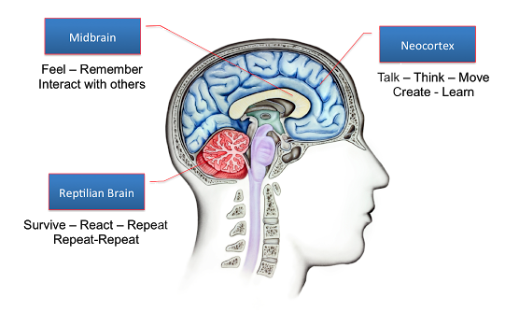
This is your brain…
Notes:
Here’s your brain. Here are the areas of the frontal lobe that are most active when things are going well, you feel calm and cool and put-together. This is the time when we do our best work and make the best choices because there’s not much emotion involved.
Usually, the times it’s the toughest to do and say the right things are the times when we’re feeling mad or sad…frustrated…upset. When we make decisions out of anger, fear or frustration, the thinking part of our brain (the frontal lobe) shuts down (less blood flow) and the reptilian part of our brain becomes hyperactive (more blood flow). This includes fight/flight/freeze.

Slide 10
Notes:
When that happens, suddenly things don't go quite as well with the behavior circle. Let’s try an example. Ask students to provide a few additional examples from school (cutting in line, etc.). Then, your reptilian brain kicks in and all kinds of decisions are being made with the wrong part of your brain…the part that fights or runs away or freezes…instead of the part that thinks calmly and rationally and clearly.

Slide 11

Notes:
So the key is…staying calm, even when something frustrates you or makes you mad, sad, upset.

Slide 12
Notes:
Let’s take those same examples and run through the behavior circle again…predicting how the outcome will be different if we use our frontal lobe more and our reptilian brain less.

Slide 13
Notes:
Here’s the good news…when we do a good job of using our frontal lobe and not letting other people make us upset, mad, sad or frustrated, we stay in control of ourselves, even if the other person is out of control. So…who gets in trouble? You or them?

Slide 14
End of Part II

Slide 15
Part III:
Making good choices is easier when we take charge of ourselves and let others do the same.

Slide 16
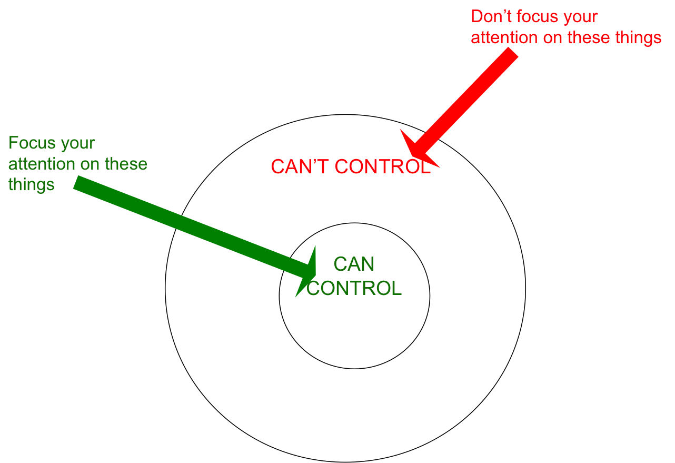
When done, turn & talk
Notes:
Let’s talk about control circles. What I control vs. what I cannot control. Jot down a few things that belong in each circle. Share with a peer.

Slide 17
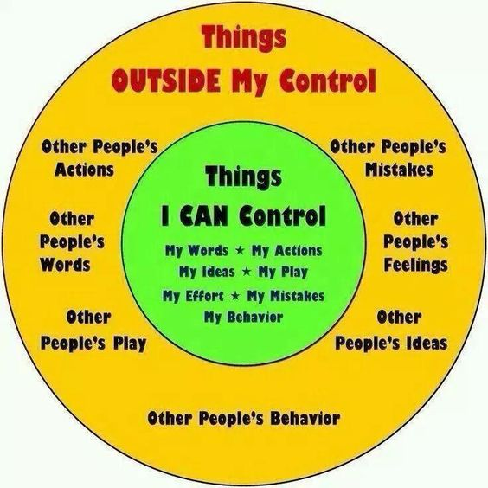
Notes:
When someone starts to push your buttons, think through the behavior circle and the control circles. What CAN you control that will lead you to an outcome where you will say “I’m better off right now because of the choice I made to handle this situation.”

Slide 18
Another way to think about it…
1:07
Notes:
A teen’s viewpoint. https://www.youtube.com/watch?v=0DUW18I-MZM

Slide 19



What should I do when
I get triggered?
TRIGGER!
Ignore
Choice A.
Walk Away
Choice B.
Ask for Help
Choice C.
Notes:
When you handle these conflicts like this, it’s more likely you’re going to stay out of trouble and more likely the other person will get into trouble. Let them suffer the consequences of their poor choices. That’s the best way for them to learn to do better. If someone’s going to get in trouble, make sure it’s not you!

Slide 20
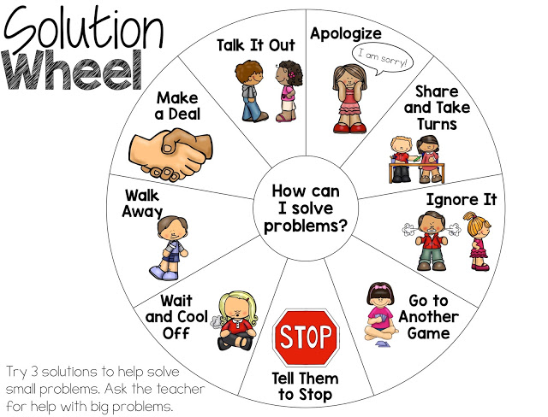
What else could I do?
Notes:
Here are some other ideas you could try (paper copy to hang up in room).

Slide 21
End of Part III

